Slide 1

Machine Learning
Lee Sutton
Jordan Lui
December 6, 2016

Slide 2
Topics
What is Machine Learning?
Types of Machine Learning
Regression
Classification
Considerations
Overfitting
Regularizing

Slide 3
What is Machine Learning
Algorithms that improve performance through experience

Slide 4
What is Machine Learning
Some Terminology
Input (x). This is the input data we feed into a ML model
Target (t). These represent the “answers” to training
Weights or parameters (w)

Slide 5
Types of Machine Learning

Slide 6
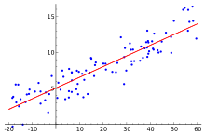
Regression
Like fitting a trendline through data points in Excel
We start with:
Some existing points
An estimate of the model structure (polynomial, sinusoid, other)
I.E. y = mx + b. More generally: y = w₀ + w₁x + w₂x² + w₃x³ + … w_{n}x^{n}
We let the ML model determine the optimal weight values to solve our system

Slide 7
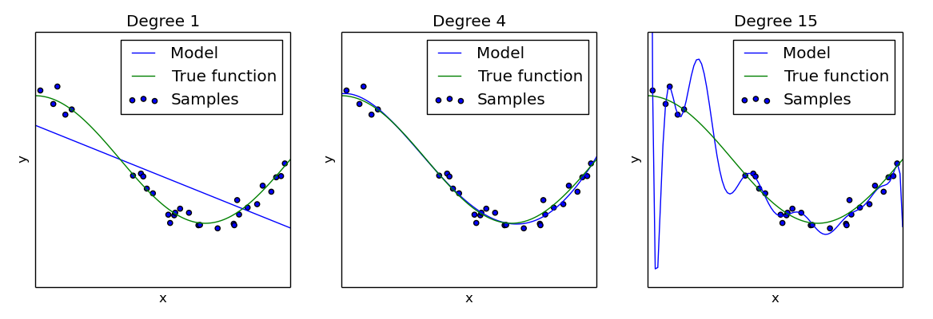
Regression: Overfitting
Why not use the highest order polynomial possible?
Overfitting!
We might fit the training data really well with a large order polynomial
However the model may perform poorly against its test data

Slide 8
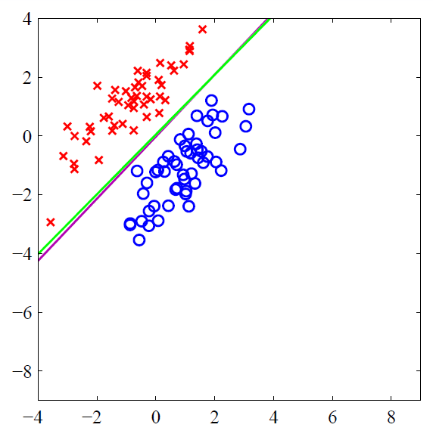
Classification
Separating points into classes
Is this image a cat or a dog?
Is this tumor sample benign or malignant?

